Slide 1
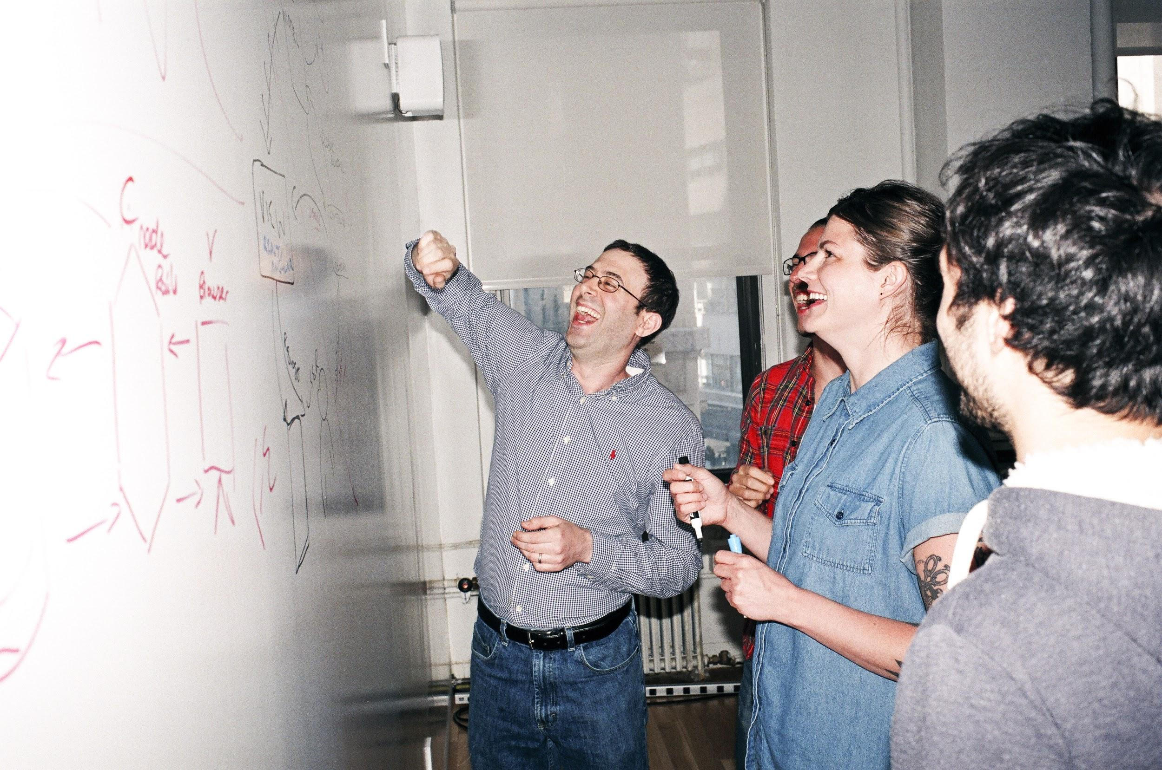

Welcome to General Assembly
WiFi GA Guest
Password yellowpencil
Notes:
[Leave this slide visible until presentation starts]

Slide 2
Course Plan
Final Countdown!

Slide 3
Lesson 17 - Review
FINAL PROJECT
- Final Project split into 4-parts: [Review with James 5mins]
(a) Real-world Problem Identification [Lesson 14]
(b) Data Cleaning [Lesson 15]
(c) Model & Validation [Lesson 16]
(d) Presentation & Storytelling [Lesson 17]
Lesson 18 – any final queries
Lesson 19 & 20 – Presenting final project back to class
ONE WEEK LEFT!!!

Slide 4
DAT11SYD - FINAL PROJECT GUIDELINES
30-mins per person: 25mins presenting [25m] + 5mins Question time[5m]
1 feedback sheet per person, per presentation – be constructive
Pitch audience: Technical Senior Management ➔ Good mix between technical understanding & business acumen
Key points to get across in your presentation:
Motivation - Business Problem / Real World Problem description [4m]
Your idea / proposed solution (e.g. going to solve using techniques X+Y) [1m]
Data Preparation – What is available / what challenges faced? [5m]
Methodology – What model/technique you used / what you learned [5m]
Validated Results – How well did the model perform on DEV and TEST? [5m]
Conclusions – Explain anything unexpected & Sell the successes [5m]
Q+A [5m]

Slide 5
DAT11SYD – Final Project Presentation Roster
Presenter | Day | Timeslot | Title
Suren Chandrasekera | Monday | 18:00
Jon Workman | Monday | 18:30
Andrew Ren | Monday | 19:00
Mai Anh Ly | Monday | 19:30
Swernim Bhardwaj | Monday | 20:30
Ricardo Valencia | Monday | 20:30
Presenter | Day | Timeslot | Title
Evan Wong | Wednesday | 18:00
John Niyonsaba | Wednesday | 18:30
Renee Checchin | Wednesday | 19:00
Michael Tostee | Wednesday | 19:30
Sophia Cherem Lopes | Wednesday | 20:00
Sung Choi | Wednesday | 20:30
Any issues – let us know!

Slide 6
DATA SCIENCE
DAT11SYD
Lesson 17: Artificial Neural Networks

Slide 7
Git & GitHub – 1 Pager Guide!

Slide 8
LEARNING Have you ever questioned what this is?
DATA SCIENCE PART TIME COURSE

Slide 9
Kinds of Learning in Nature
Individual Learning - Individual survival is important (as well as survival of species) - High independent intelligence - Learning by observation as well as trial & error - Individual / localised communication - Individual awareness & high-level decisions made consciously
Group Learning - Hive survival important (individuals are not important) - “Hive/Swarm” Intelligence (Low individual intelligence) - “Learning” by shotgun approach (feedback loop) - Communication by global broadcasting (pheromones) / not individually targeted - Complex mathematical problems often solved by optimising something specific

Slide 10
Examples: Learning in Nature
Individual Learning Dolphins - https://www.youtube.com/watch?v=HQ38sycAITQ Octopus - https://www.youtube.com/watch?v=GQwJXvlTWDw
Group Learning Ants Colony Optimisation: https://www.youtube.com/watch?v=GQwJXvlTWDw Double Bridge Experiment: https://www.youtube.com/watch?v=3oCQ2DWAp4c Bees Defensive Adaptation: https://www.youtube.com/watch?v=3P8svtzTRul TED Talk: https://www.youtube.com/watch?v=LHgVR0lzFJc

Slide 11
Artificial Learning
Based upon fundamental principles of learning in nature:
Specific problem to solve: “Do X more efficiently”
INCENTIVISED: REWARD / PENALTY - Positive behavior reinforced - Negative behavior discouraged
FEEDBACK LOOP (Positive Feedback Loop, etc)
…with a few extra technical tricks thrown in.

Slide 12
WHAT IS A NEURAL NETWORK?
DATA SCIENCE PART TIME COURSE

Slide 13

The NEURON – The basis of a Biological Neural Network
Notes:
The neuron receives its inputs along antennae-like structures called dendrites
Each of these incoming connections is dynamically strengthened or weakened based on how often it is used (weights!)
The strength of each connection that determines the contribution of the input to the neuron’s output.
After being weighted by the strength of their respective connections, the inputs are summed together in the cell body. This sum is then transformed into a new signal that’s propagated along the cell’s axon and sent off to other neurons.

Slide 14
The NEURON - simplified
Process & Combine inputs
inputs
outputs
Output signal
Notes:
The neuron receives its inputs along antennae-like structures called dendrites
Each of these incoming connections is dynamically strengthened or weakened based on how often it is used (weights!)
The strength of each connection that determines the contribution of the input to the neuron’s output.
After being weighted by the strength of their respective connections, the inputs are summed together in the cell body. This sum is then transformed into a new signal that’s propagated along the cell’s axon and sent off to other neurons.

Slide 15
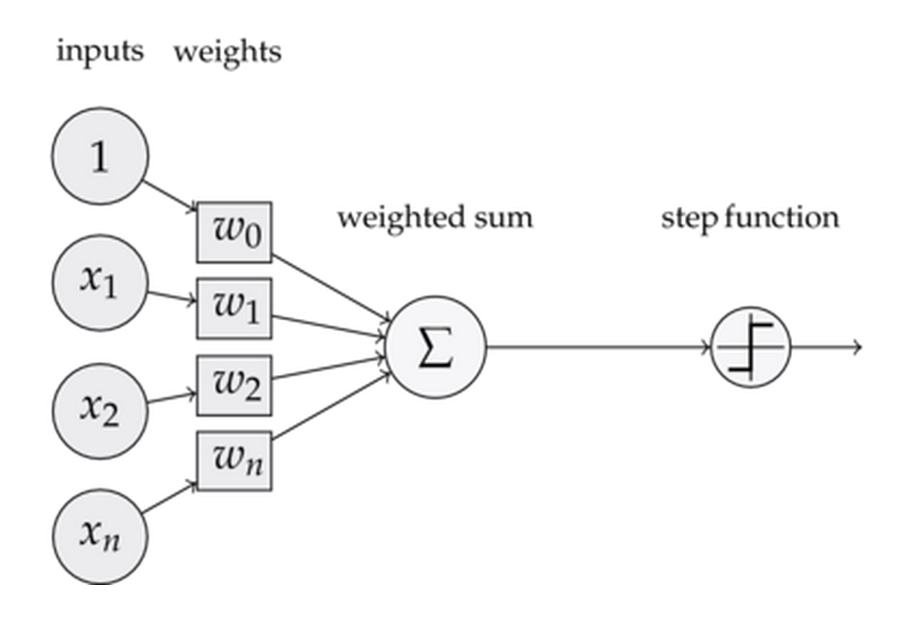
PERCEPTRON – The basis of the Artificial Neural Network
A way of representing the relative importance of the attribute
These are like your “Coefficients” from Linear / Logistic Regression Modelling
Features / Attributes
“Mapping”
A way to aggregate the contribute from each input to create a single value
Activation Function
Linear
Non-linear (e.g. Sigmoidal)

Slide 16
WHAT IS AN ARTIFICIAL NEURAL NETWORK?
A computational system comprised of layers and each layer is built of interconnected perceptrons

Slide 17
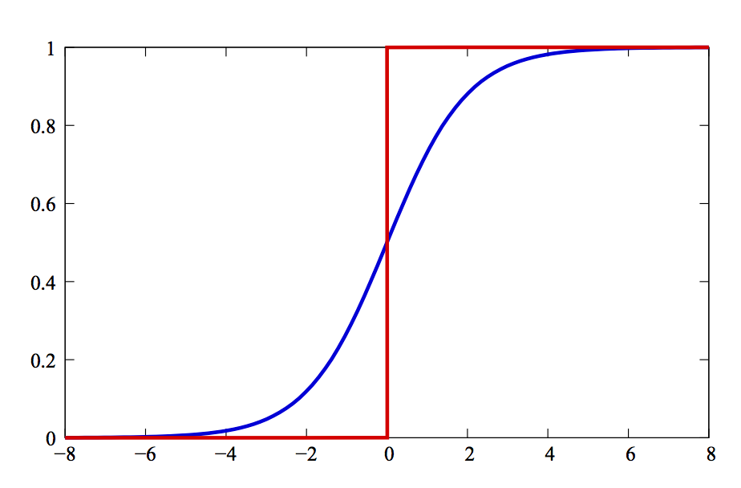
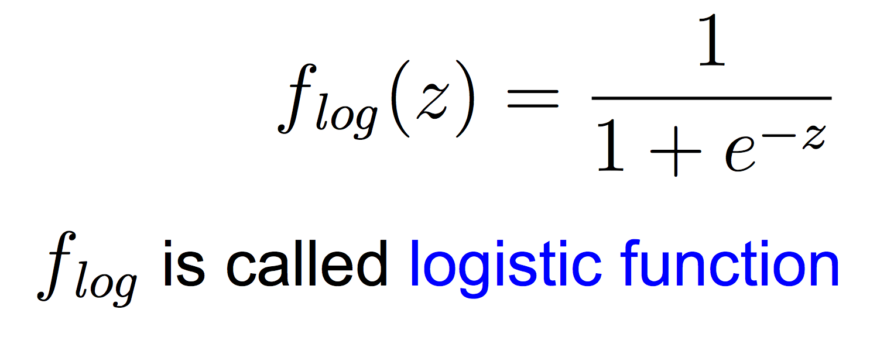
SINGLE PERCEPTRON
Takes in input and uses an activation function in order to output
Notes:
Just like we have used in logistic regression.
Log(odds)

Slide 18
SINGLE PERCEPTRON
Takes in input and uses an activation function in order to output
What is z?

Slide 19
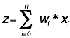
SINGLE PERCEPTRON
Takes in input and uses an activation function in order to output.
z is a weighted sum on the inputs.
Where wi is the weight on input xi

Slide 20
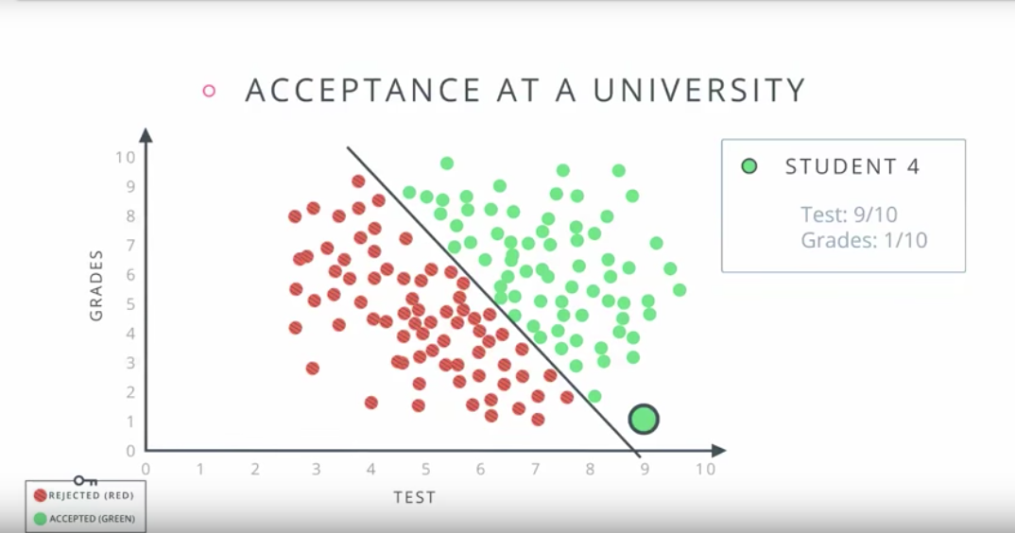
Simple Example

Slide 21
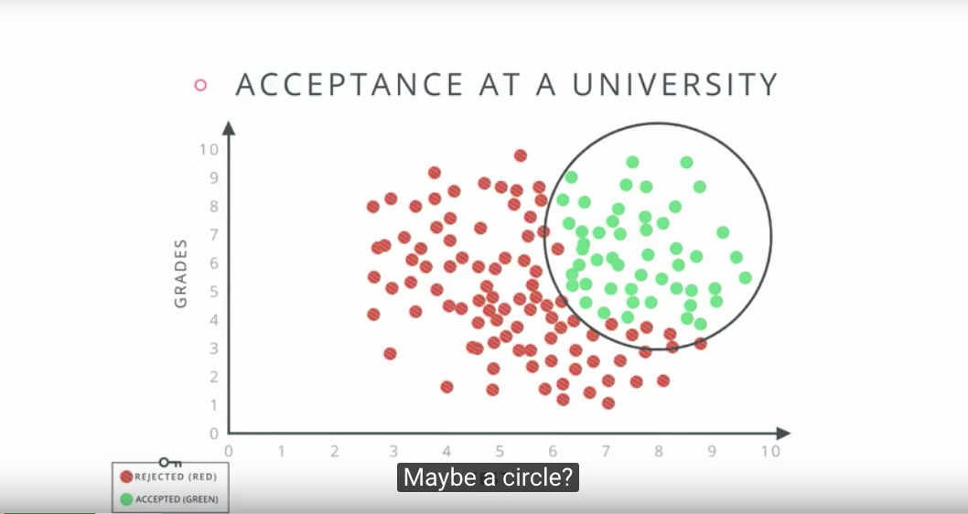
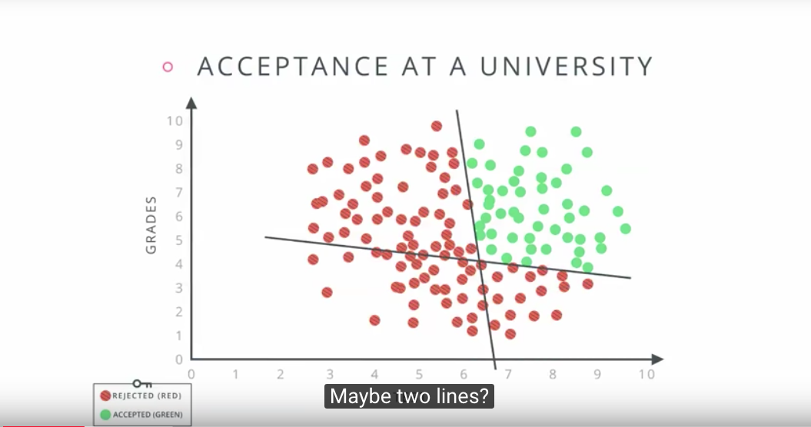
Simple Example

Slide 22
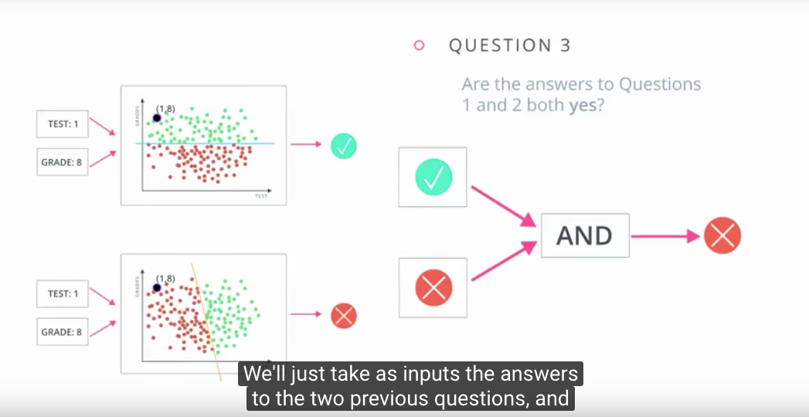
Simple Example

Slide 23
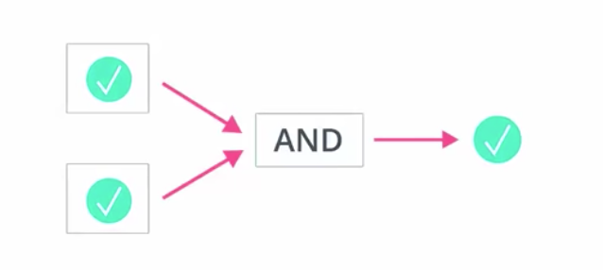
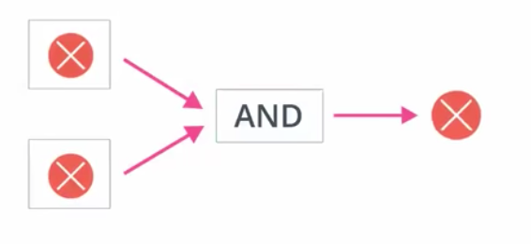
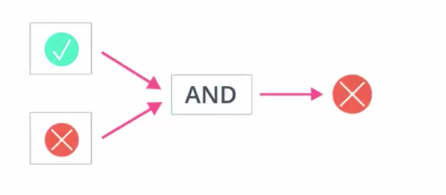
Simple Example
[1,1] => 1
[0,0] => 0
[1,0] => 0
[0,1] => 0
pseudocode: if(sum == 2) then 1 else 0

Slide 24
Some other possible Logic Functions:
http://www.schoolphysics.co.uk/age16-19/Electronics/Logic%20gates/text/Logic_gates/index.html

Slide 25
SINGLE PERCEPTRON

Slide 26
SINGLE PERCEPTRON
If f(z) if above a threshold, generally called theta, then the neuron “activates”

Slide 27
NETWORK STRUCTURE
DATA SCIENCE PART TIME COURSE

Slide 28
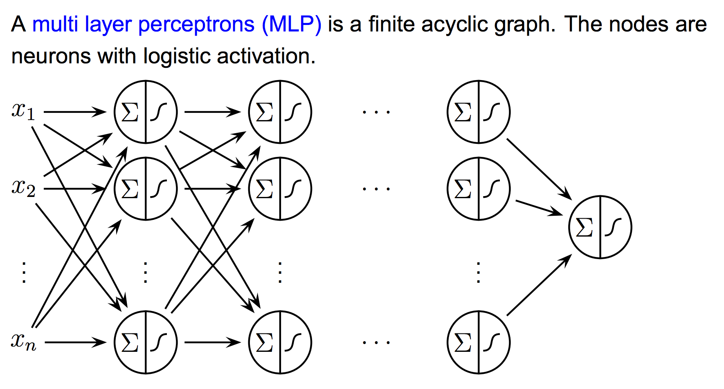
MULTI-LAYER PERCEPTRON
Output layer
Input layer
Several hidden layers
Notes:
the human cerebral cortex (the structure responsible for most of human intelligence) is made of six layers

Slide 29
WHAT IS AN ARTIFICIAL NEURAL NETWORK?
Cat
Input Layer - the original features of our dataset (our X)
Hidden Layer - these are the derived features of the network. They are called hidden because they are not directly observed.
Output Layer - the final transformation of the inputs into a result

Slide 30
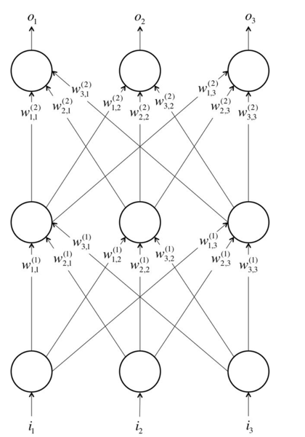
NETWORK STRUCTURE
Output Layer ->
Hidden Layers ->
Input Layer ->

Slide 31
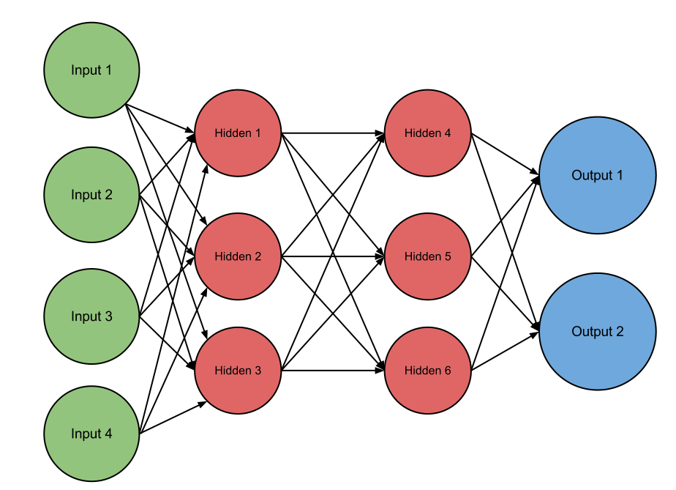
NETWORK STRUCTURE
Hidden layers often have fewer neurons than the input layer to force the network to learn compressed representations of the original input.
Notes:
hidden layers often have fewer neurons than the input layer to force the network to learn compressed representations of the original input

Slide 32
NETWORK STRUCTURE
Architecture
Neuron connections

Slide 33
HOW DO WE FIND THE WEIGHTS?
DATA SCIENCE PART TIME COURSE

Slide 34
BACK-PROPAGATION
DATA SCIENCE PART TIME COURSE

Slide 35
BACK-PROPOGATION
Training updates the sigmoid function weights to get the best predictions possible.
If an observation goes through the model and is outputted as False when it should have been True the logistic functions in the perceptrons are changed slightly according to the error.

Slide 36
BACK-PROPOGATION
Back-Propogation is a two-pass algorithm.
The Forward pass uses the weights to calculate the prediction.
The Backward pass calculates the errors on the output layer and are then back-propagated to give the errors at the hidden layer units.
The weights must then be updated.
Lather, Rinse, Repeat. (Until some criterial is satisfied)

Slide 37
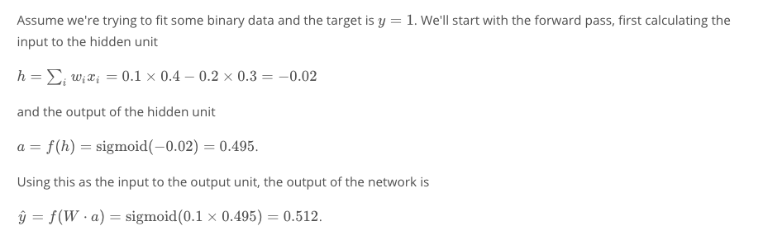
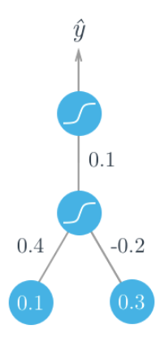
BACK-PROPOGATION: Simple 3-layer example

Slide 38
BACK-PROPOGATION: Simple 3-layer example
Output value
[Target value y = 1]
Output layer
(layer 3)
w3
Hidden layer (layer 2)
a
w1
h
w2
Input layer (layer 1)
x1
x2

Slide 39
BACK-PROPOGATION: Simple 3-layer example
x1
w1
x2
w2
Output value
[Target value y = 1]
Output layer
(layer 3)
w3
Hidden layer (layer 2)
a
w1
h = -0.2
w2
Input layer (layer 1)
x1
x2

Slide 40
BACK-PROPOGATION: Simple 3-layer example
x1
w1
x2
w2
Output value
[Target value y = 1]
Output layer
(layer 3)
w3
Hidden layer (layer 2)
a = 0.495
w1
h = -0.2
w2
Input layer (layer 1)
x1
x2

Slide 41
BACK-PROPOGATION: Simple 3-layer example
Calculated value = 0.512
x1
w1
x2
w2
Output value
[Target value y = 1]
Output layer
(layer 3)
w3
Hidden layer (layer 2)
a = 0.495
w1
h = -0.2
w2
Input layer (layer 1)
x1
x2

Slide 42
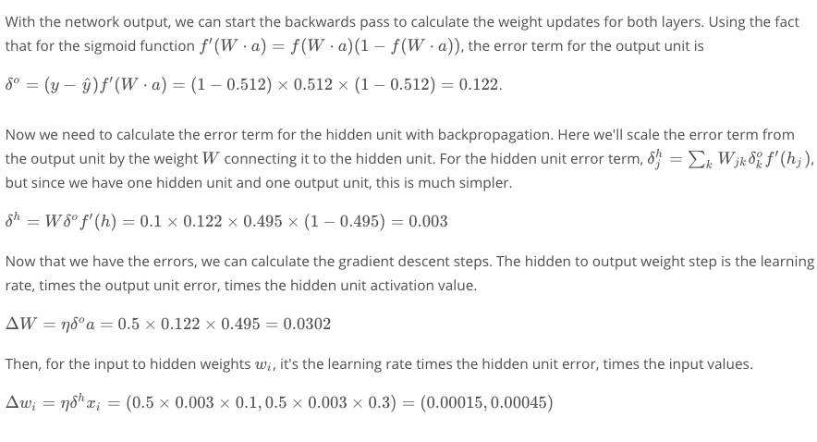
BACK-PROPOGATION
Output value
[Target value y = 1]
Output layer
(layer 3)
w3
Hidden layer (layer 2)
a = 0.495
w1
h = -0.2
w2
Input layer (layer 1)
x1
x2

Slide 43
A word about: Learning Rate
Exactly what is says!
(Cats example)
Can be thought of as “How quickly the model adapts to new information”
High Learning rate => Algo adapts quickly (but may jump around!)
Low Learning rate => Algo adapts steadily (will take longer to train)
Chosen by the user (reasonable default = 0.5)
Notes:
The learning rate is how quickly a network abandons old beliefs for new ones.
If a child sees 10 examples of cats and all of them have orange fur, it will think that cats have orange fur and will look for orange fur when trying to identify a cat. Now it sees a black a cat and her parents tell her it's a cat (supervised learning). With a large “learning rate”, it will quickly realize that “orange fur” is not the most important feature of cats. With a small learning rate, it will think that this black cat is an outlier and cats are still orange.
Okay, the example is a bit of a stretch. The point is that a higher learning rate means the network changes its mind more quickly. That can be good in the case above, but can also be bad. If the learning rate is too high, it might start to think that all cats are black even though it has seen more orange cats than black ones.
In general, you want to find a learning rate that is low enough that the network converges to something useful, but high enough that you don't have to spend years training it.

Slide 44
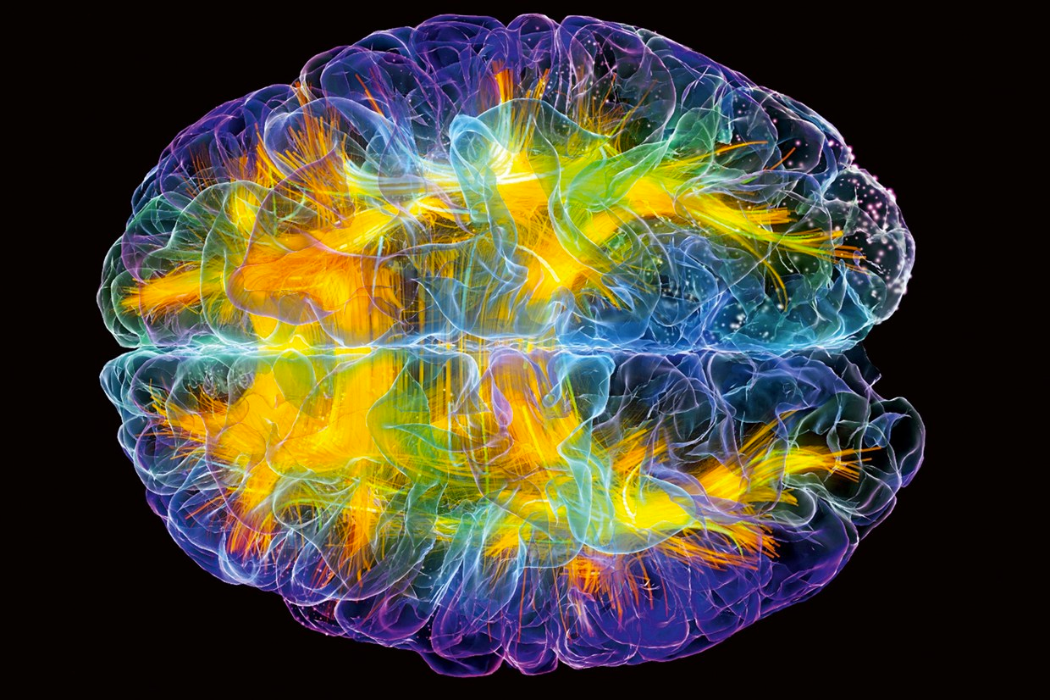
LAB
Perceptron - Back Propagation Example

Slide 45
BACK-PROPOGATION
Pros
Can approximate almost any type of function
Easier to run
Very topical area of machine learning (lots of investment)
Cons
Requires many training samples to be considered good
Hard to describe what is happening
Requires a lot of hardware / computation power
Slow to train

Slide 46
WHY ARE NEURAL NETWORKS IN VOGUE?
DATA SCIENCE PART TIME COURSE
#topical #trending #rage

Slide 47
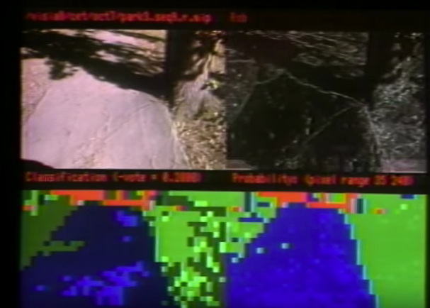
DEEP LEARNING
NavLab 1986 Carnegie Mellon - 1st self Driving Car
https://www.youtube.com/watch?v=ntIczNQKfjQ

Slide 48
DEEP LEARNING
Uber Self Driving Car

Slide 49
DEEP LEARNING
Tesla Model 3

Slide 50
DEEP LEARNING
Assistants

Slide 51
DEEP LEARNING
Facebook Auto Tagging

Slide 52
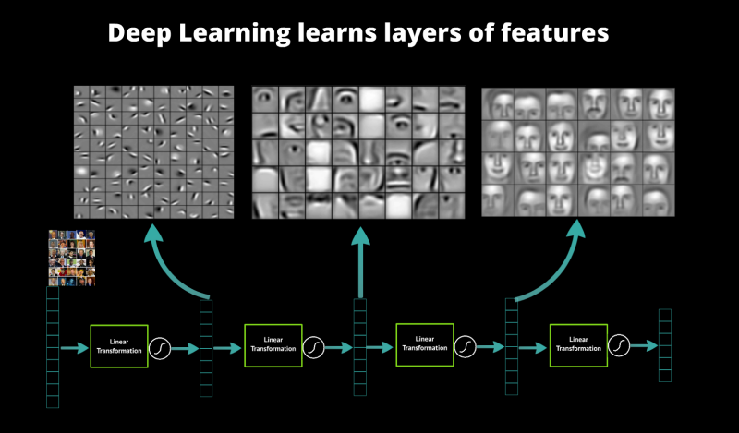
DEEP LEARNING

Slide 53
DEEP LEARNING
When is deep learning the right choice of algorithm?
When the input features are dense:
Images
Videos
Audio
Text

Slide 54
DEEP LEARNING
When is deep learning the right choice of algorithm?
When the input features are dense:
Images
Videos
Audio
Text
Some recent interesting applications:
Colorisation of Black and White Images.
Adding Sounds To Silent Movies.
Automatic Machine Translation.
Object Classification in Photographs.
Automatic Handwriting Generation.
Character Text Generation.
Image Caption Generation.
Automatic Game Playing.

Slide 55
DEEP LEARNING
Video on what neural networks see. Helpful for realising how the networks learns to distinguish through transformations.
https://aiexperiments.withgoogle.com/what-neural-nets-see

Slide 56
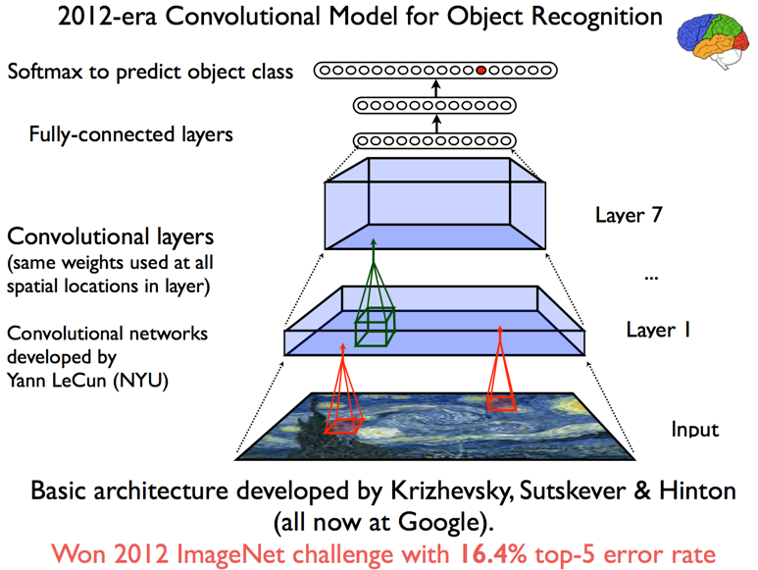
DEEP LEARNING

Slide 57
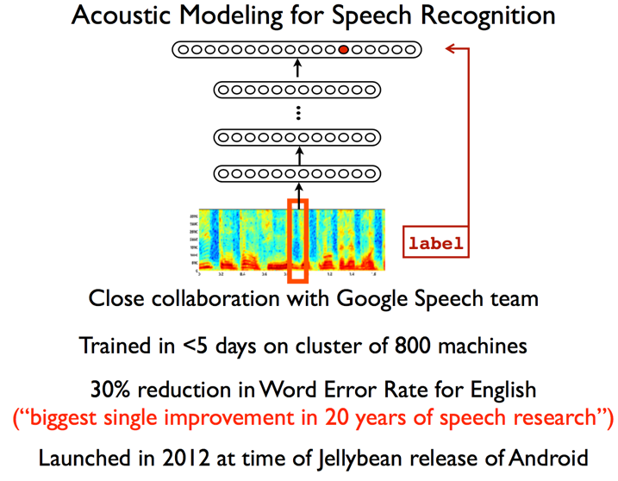
DEEP LEARNING

Slide 58
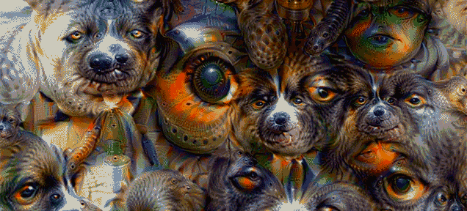
GOOGLE DEEP DREAM
http://deepdreamgenerator.com/

Slide 59
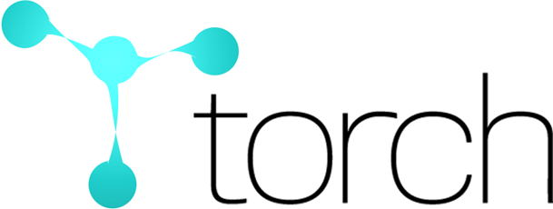



ARTIFICIAL NEURAL NETWORK TECHNOLOGIES
No longer supported
TensorFlow™ is an open source software library for numerical computation using data flow graphs. Nodes in the graph represent mathematical operations, while the graph edges represent the multidimensional data arrays (tensors) communicated between them.

Slide 60

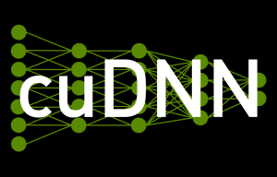
ARTIFICIAL NEURAL NETWORK TECHNOLOGIES
GPUs for processing

Slide 61
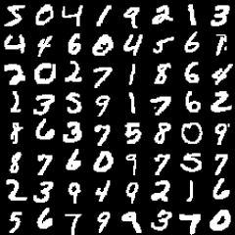
DEEP LEARNING
A demo of deep learning being applied in the browser:
http://cs.stanford.edu/people/karpathy/convnetjs/demo/mnist.html

Slide 62
HOMEWORK
Homework
Prepare you project presentations
Extra Reading
Evaluation of deep learning frameworks: https://github.com/zer0n/deepframeworks/blob/master/README.md
Beginner: Fundamentals of Deep Learning - Nikhil Budhema (http://shop.oreilly.com/product/0636920039709.do)
Advanced: Deep Learning - Ian Goodfellow, Yoshua Bengio, Aaron Courville (http://www.deeplearningbook.org/)
DATA SCIENCE

Slide 63
DAT11SYD - FINAL PROJECT GUIDELINES
30-mins per person: 25mins presenting [25m] + 5mins Question time[5m]
1 feedback sheet per person, per presentation – be constructive
Pitch audience: Technical Senior Management ➔ Good mix between technical understanding & business acumen
Key points to get across in your presentation:
Motivation - Business Problem / Real World Problem description [4m]
Your idea / proposed solution (e.g. going to solve using techniques X+Y) [1m]
Data Preparation – What is available / what challenges faced? [5m]
Methodology – What model/technique you used / what you learned [5m]
Validated Results – How well did the model perform on DEV and TEST? [5m]
Conclusions – Explain anything unexpected & Sell the successes [5m]
Q+A [5m]

Slide 64
LAB
DATA SCIENCE PART TIME COURSE

